Slide 1
New Year 7
‘Parents Welcome Evening’
The John Fisher School

Slide 2
This Evening
Mr Evans – Assistant Headteacher
Mr Fell – Year 7 Director of Learning
Mr Street – Head of Sport
Mr McCullagh - Headteacher

Slide 3
Mr Fell
Year 7 Director of Learning

Slide 4
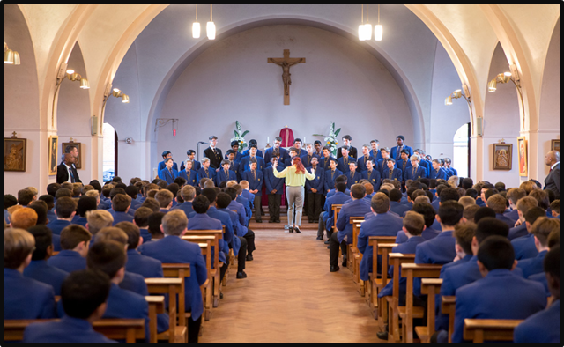
Transition
Joining Secondary School is a significant and important step in your sons education and life
How are you feeling about it?

Slide 5
Mr Fell – Year 7 Director of Learning
Primary School Visits
Form Groupings decided considering a range of factors
Handbook for new Parents/Carers – to be released through Edulink this week
This includes information on school structure, expectations, uniform and much more
Permissions to respond to via Edulink detailed in Booklet
Frequently Asked Questions section

Slide 6
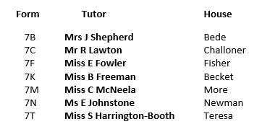
Structure
Mr Evans, Assistant Headteacher and Year 7 Link
Mr Fell, Year 7 Director of Learning
Form Tutors

Slide 7
Mission Statement
Nurturing young Catholic gentlemen Aspiring for Academic, Cultural & Sporting Excellence

Slide 8
School Values
Acceptance
Service
Perseverance
Integrity
Respect
Enjoyment
Selflessness

Slide 9
Aims for Year 7 2021/22
To ensure that the transition from Primary to Secondary school is successful, smooth and stress-free.
The Pandemic – anxiety, missed learning, missed opportunities, family bereavements
Support
The most important Year Group
Zoom meetings with new Form Tutors
Tutor Welcomes
Welcome videos on the website

Slide 10
Mr Fell’s advice
Be Positive
Be Prepared
Do Your Best

Slide 11
Wellbeing
The Form Tutor and Director of Learning
Pink Lanyards
Wellbeing Ambassadors
Inclusion Team
Wellbeing Garden
Talkeasy Trust
Transition Support Sessions

Slide 13
Parental Support
Edulink
Satchel One (Show My Homework)
Parent Pay
Support
Talk about the school day
Reading
Work with us and together we will develop your son to reach his full potential as a student, a Catholic and as a person

Slide 14
Rewards and Opportunities
Via Edulink
Achievement points
Bronze to Platinum Awards
Achiever of the Week
Bi-weekly Form Cup
House Captain
School Council Rep
Wellbeing Ambassadors
Extracurricular activities:
Sport
Music
Clubs

Slide 15
Behaviour/Consequences
Students make the wrong choices sometimes
Via Edulink
Behaviour Points
Behaviour Ladder
Contact from Form Tutor, Mr Fell, Mr Evans
Parents are not present in classrooms or on the playground
We investigate and come to conclusions based on the evidence we have and the context of the incident
Once the consequence is served, we expect the students to learn from it and to not repeat it.

Slide 16
Primary School vs Secondary School
Lots of teachers
Lots of subjects
Lots of classrooms
Big school site
Youngest in the school
Travelling to and from school
High expectations of behaviour and academic progress
Homework
189 students together
Developing new relationships
New Challenges, New Opportunities

Slide 17
What's Next…
Welcome Booklet: This Week (Please read Permissions Page and log into Edulink to confirm)
Tutor Profiles: Next week
Zoom meetings with Form Tutor and Director of Learning: Details to follow
Welcome Videos: On website from next week
Parentpay letter: Sent this week
Enrichment Week– w/c 23rdAugust: Confirm attendance via Edulink
New Year Start: we will communicate the arrangements for September in the light of Government advice
CATs / NGST/ NGRT testing: September

Slide 18
Bushcraft - 2 day residential – 23rd/24th September

Slide 19
Mr Street
Head of Sport

Slide 20
Welcome To The John Fisher Sports Department

Slide 21
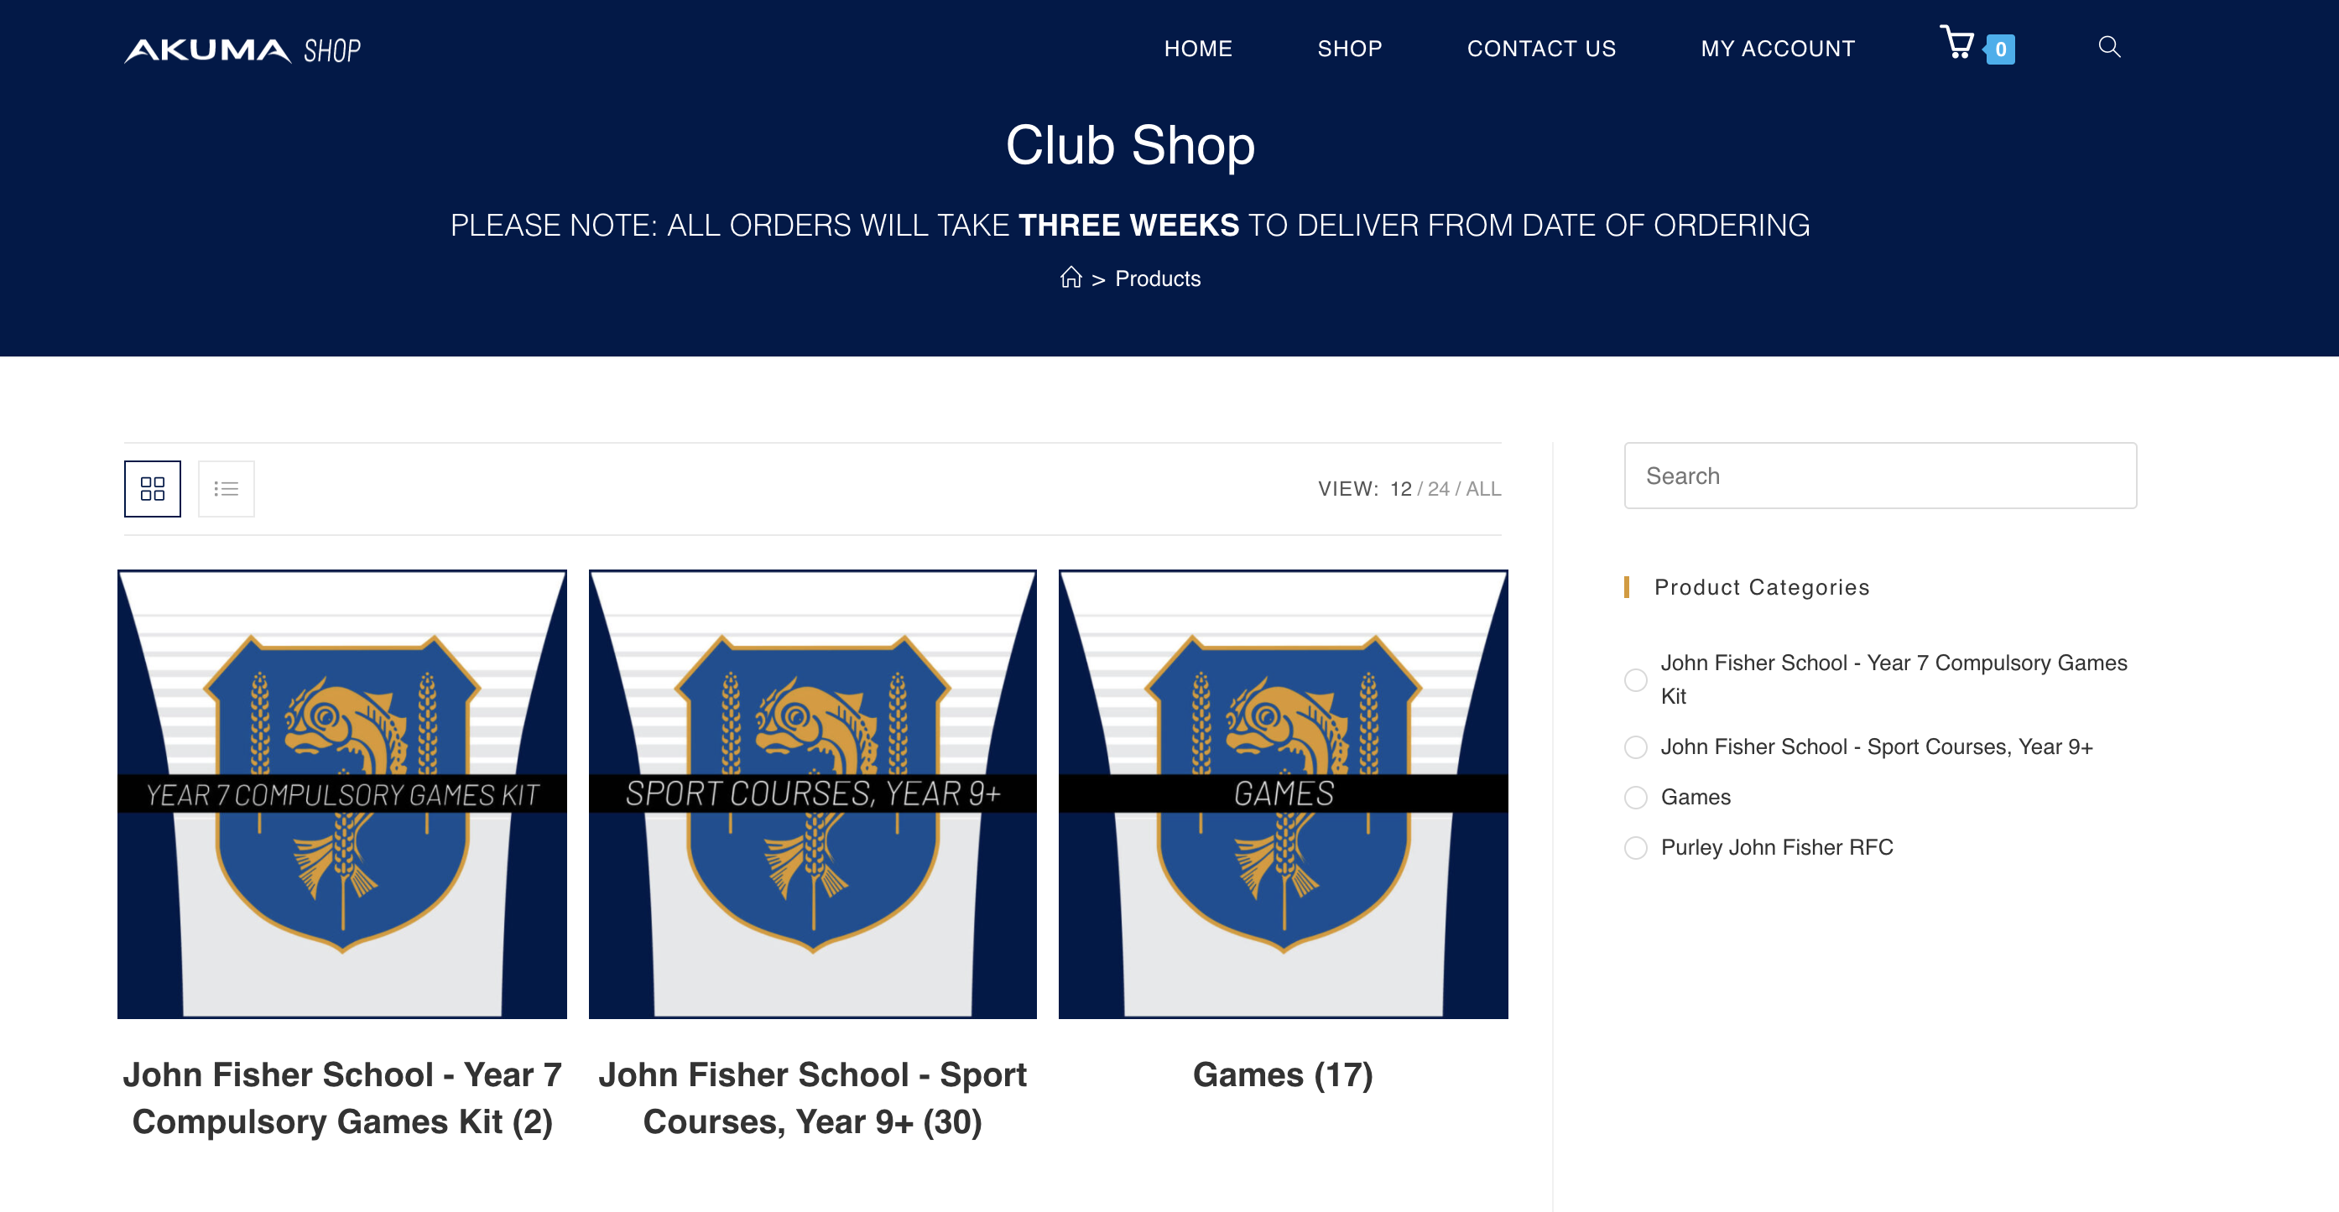
New Akuma Range

Slide 22
New Akuma Range

Slide 23
New Akuma Range

Slide 24
New Akuma Range

Slide 25
New Akuma Range

Slide 26
New Akuma Range

Slide 27
New Akuma Range

Slide 28
New Akuma Range

Slide 29
Mr McCullagh
Headteacher

